Slide 1

Collage Students and Staff Skill upliftment

Slide 2

Motive
To Make the students learn about Automotive Microcontroller programming.
To make the students skill sets for core embedded systems specifically for Embedded Software/Firmware Development.
To make students learn automotive frameworks that are used in the Industry: Autosar MCAL layer, ISO26262 Functional Safety, MATLAB Model Base designing, Cryptography Technology, Automotive protocols like : CAN, LIN, Ethernet and etc.
To make students have Handson with Automotive semiconductor chips and come out of Arduino/ESP/STM environment to make them learn Industrial required skill sets.
To have Skill based learning instead of project based learning.
To make students aware about automotive and semiconductor technology/skill sets.

Slide 3

Automotive-Semiconductor Introduction Sessions
Introduction To Semiconductor and Automotive Industry.
Introduction to microcontroller technology.
Introduction to Automotive Software Technologies.
Introduction to Automotive Hardware Technologies.

Slide 4
Learning different Embedded and Automotive technologies using automotive chips
How to learn Autosar technology using ElecronicsV3 and AutoBoardV1.
How to use EB Tresos Studio using ElecronicsV3
How to learn MATLAB Model Base Designing using ElecronicsV3 and AutoboardV1.
How to learn Automotive protocols using ElecronicsV3 and AutoboardV1.
How to learn cryptography technology using ElecronicsV3.
How to learn Functional Safety using ElecronicsV3.
How to use Industry Standard Eclipse IDE(Integrated Development Environment) used for Microcontroller programming using ElecronicsV3 and S32 Design Studio.
How to use Industry Standard Debugging tools : Segger Jlink Debugging tool for Microcontroller programming/debugging using ElecronicsV3.

Slide 5

Automotive MCU DIY Handson Sessions : Part 1
CAN Protocol Handson with Automotive MCU.
ADC peripheral Handson and Hardware Triggering Mechanism concept of automotive MCU.
TIMER peripheral Handson and PWM/Input capture mode concept of automotive MCU.
I2C Peripheral handson and I2C master/Slave demonstration concept using automotive MCU.
SPI peripheral handson wand SPI Master/Slave demonstration concept using automotive MCU.
Cryptography Handson with Automotive MCU

Slide 6

Microcontroller DIY Handson Sessions: Part 2
GPIO peripheral Handson with automotive MCU( Interfacing Keypad module)
UART peripheral handson with automotive MCU( Interfacing Meig IoT Module)
I2C peripheral handson with automotive MCU( BNO055 Gyroscope sensor)
SPI peripheral handson with automotive MCU(ST7789 LCD Screen)
Interrupt Peripheral handson and working with automotive MCU.
DMA peripheral handson and working with automotive MCU.

Slide 7
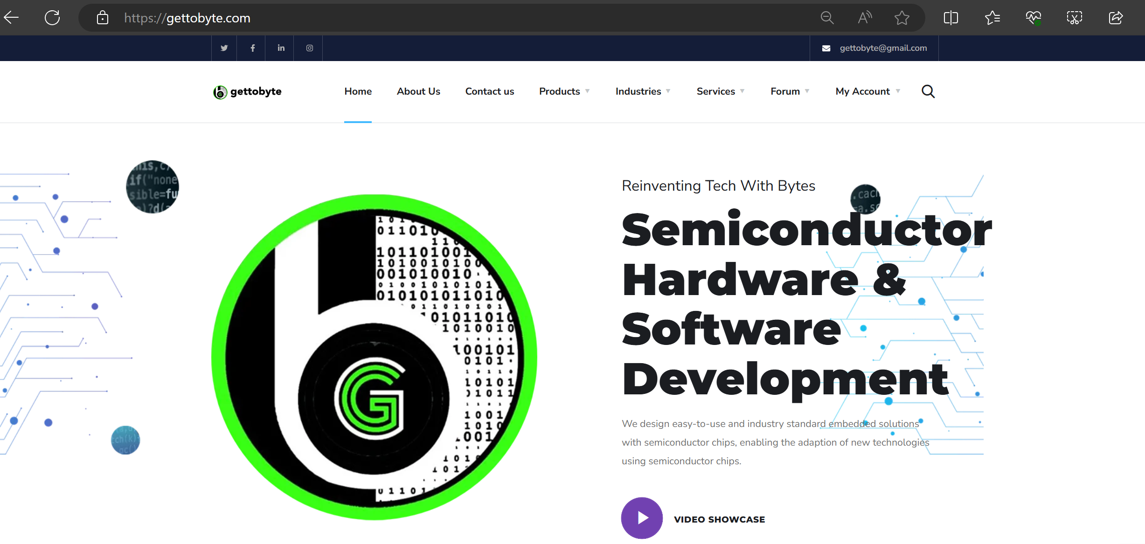
To Know More: Home - Get To Byte

Slide 8
